Slide 1
Excel Sorting and Filtering Data
By NIVED SUDHINDRAN

Slide 2
Sorting of Data
Sorting is used to list data in Ascending or Descending order based on Numbers, Dates
or Alphabetic Order.
Sorting can be done in two types-
Single Column Sorting
When sorting operation is performed on a single column
Multiple Column Sorting
When Multi-level sorting is required based on multiple columns

Slide 3
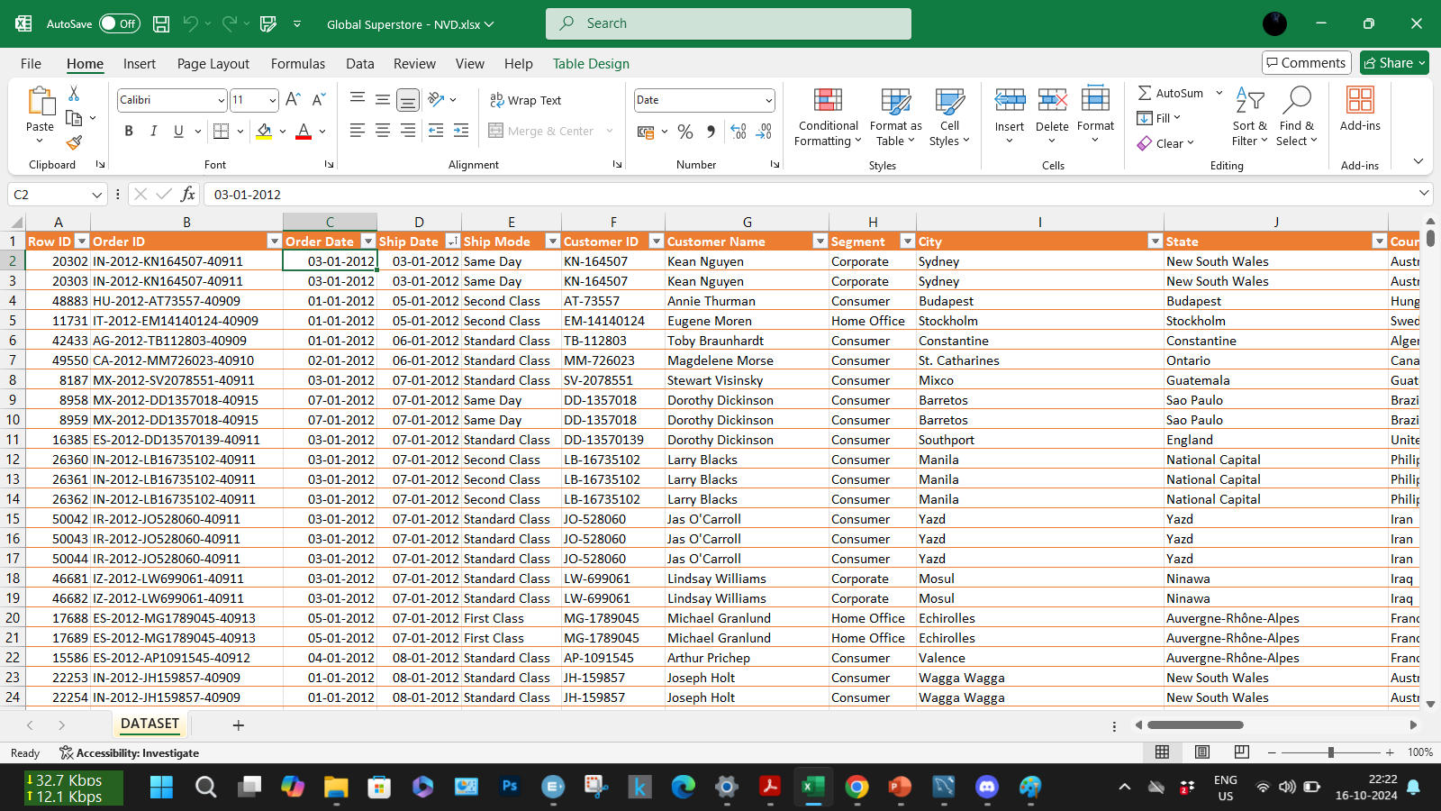
Sorting of Data

Slide 4
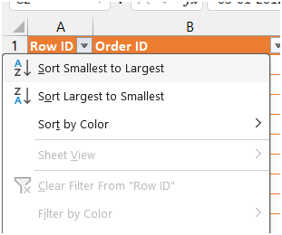
To sort data in ascending order of Row_ID
Right Click on Header Row_ID and select -
Sort Smallest to Largest
To sort data in descending order of Row_ID
Right Click on Header Row_ID and select -
Sort Largest to Smallest

Slide 5
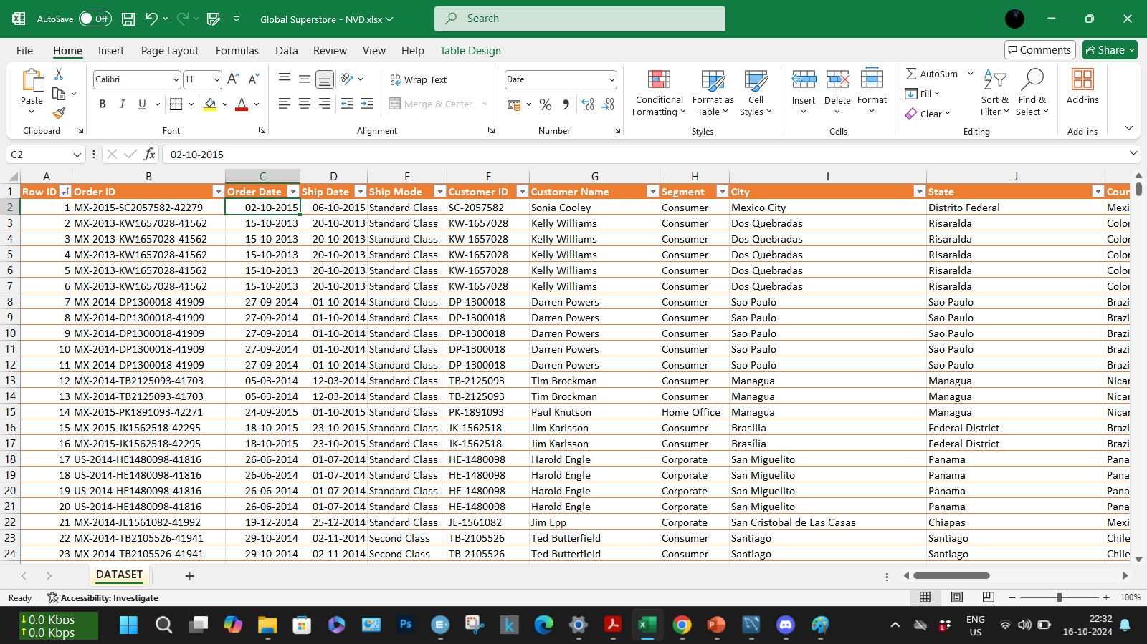
Data sorted in ascending order of “Row_ID”

Slide 6
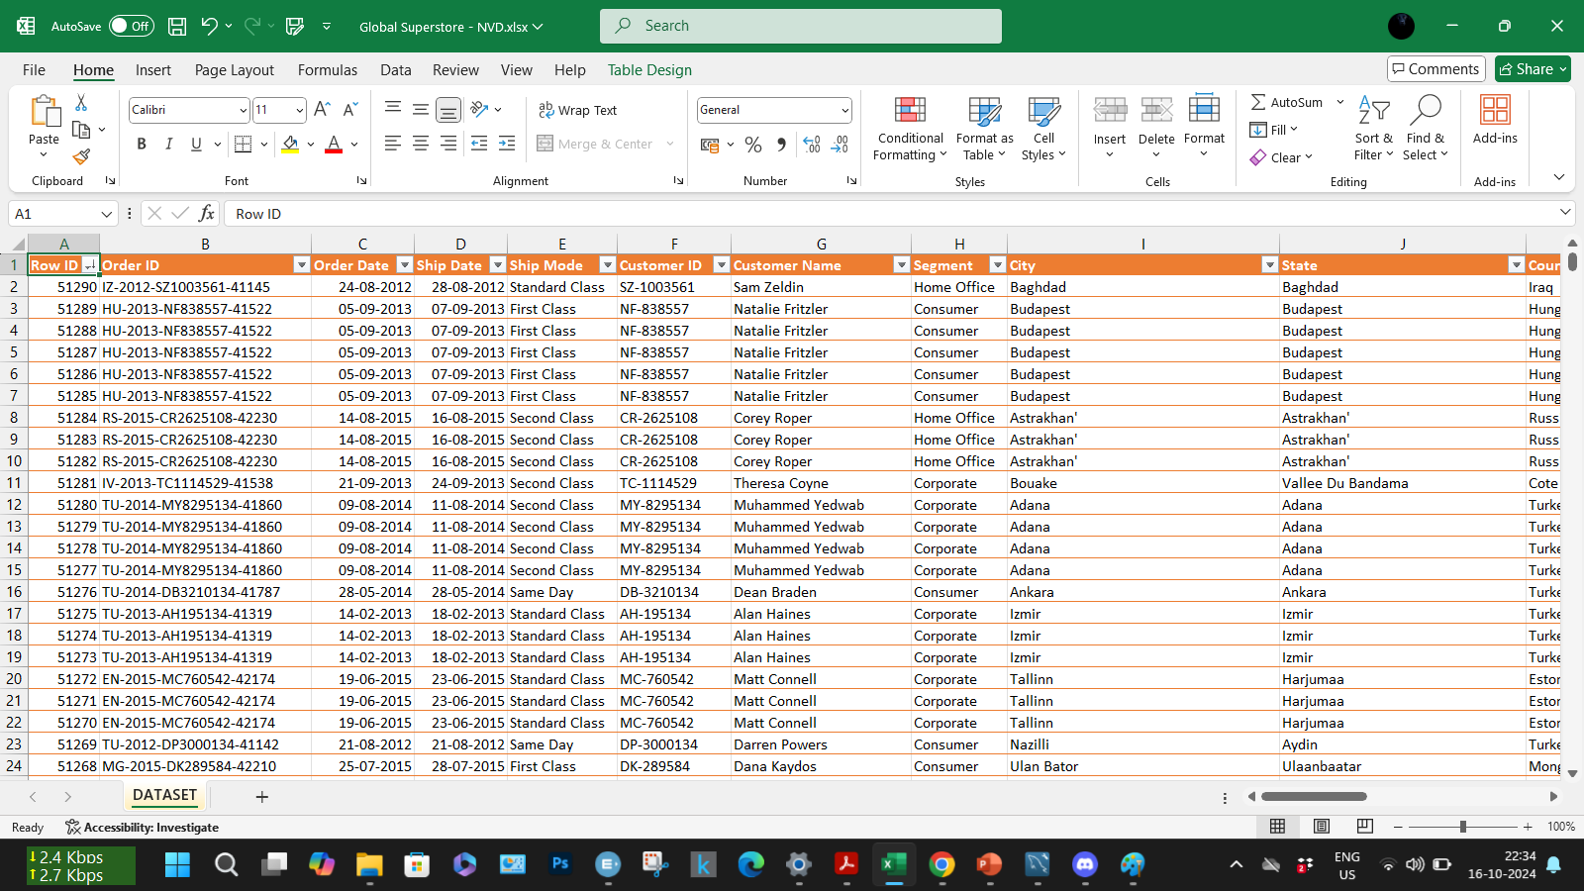
Data sorted in descending order of “Row_ID”

Slide 7
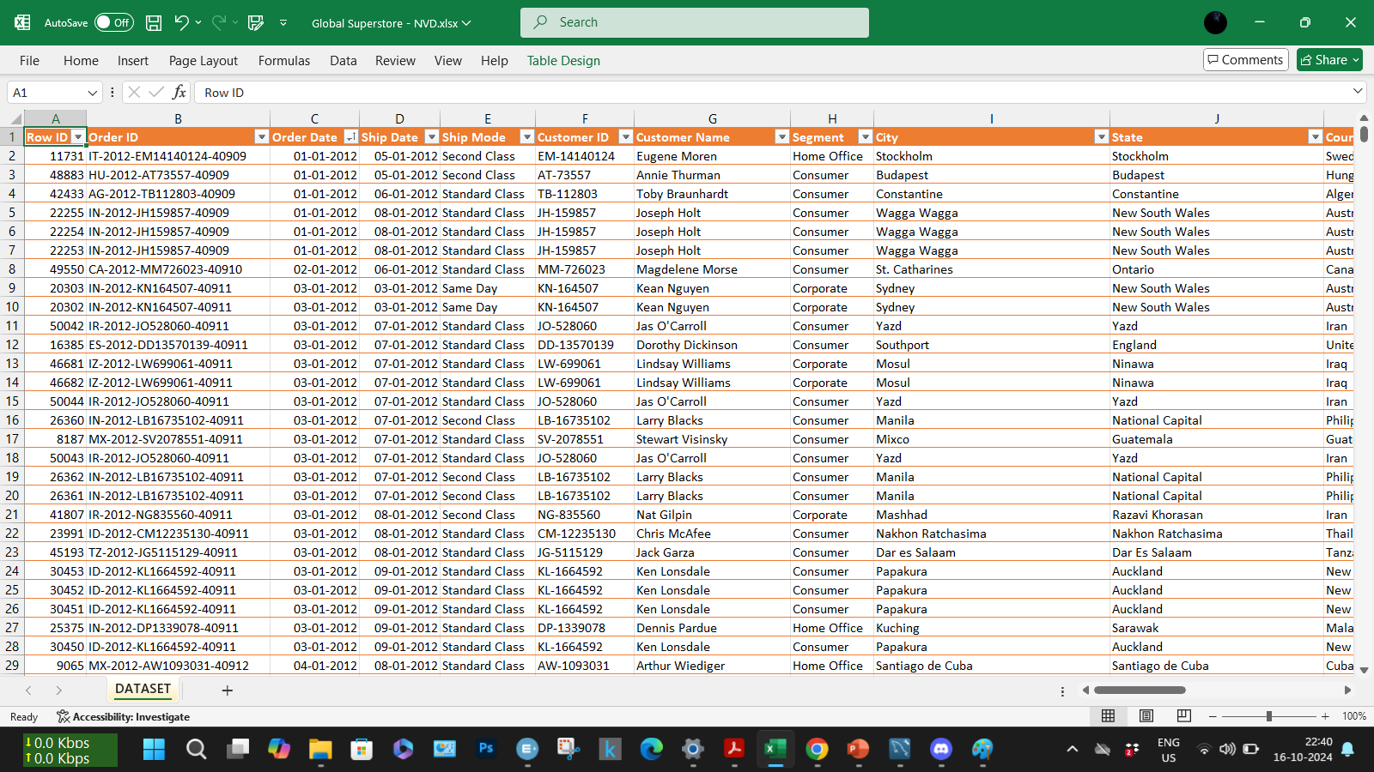
Data sorted in ascending order of “Order Date”

Slide 8
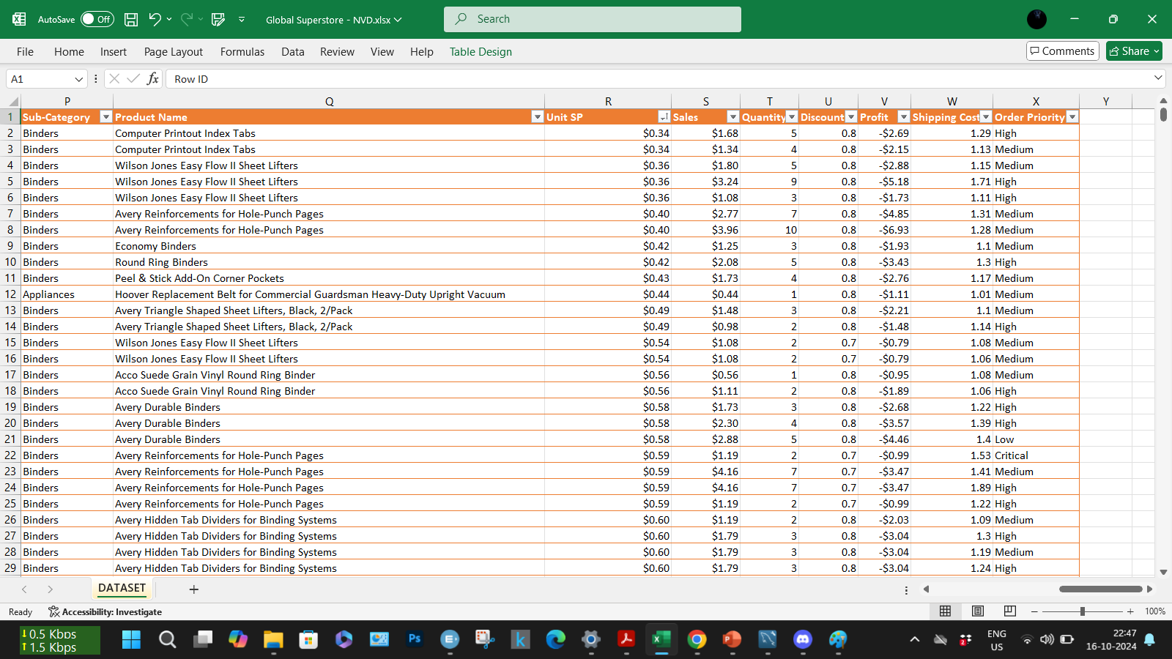
Data sorted in ascending order of “Unit SP”

Slide 9
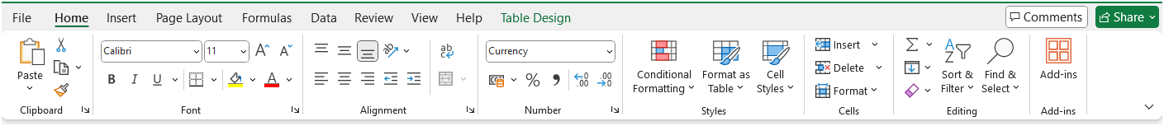
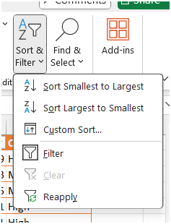
For Multi-level or Multiple Column Sorting
Go to - HOME tab → Sort & Filter
Select - Custom Sort…

Slide 10
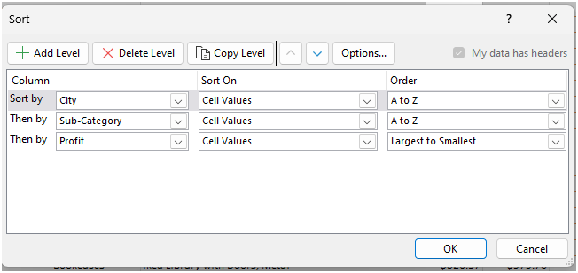
Objective: We are sorting data based on
City → Alphabetic Order
Sub-Category → Alphabetic Order
Profit → Descending Order

Slide 11
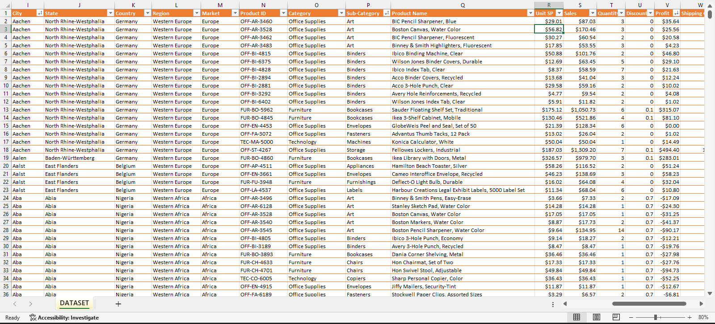
Output
Level 1
Level 2
Level 3

Slide 12
Filtering of Data
Filtering data in Excel is useful for organizing large amounts of data, making workbooks more
efficient, and analyzing data.
Focus on relevant data: Filters temporarily hide data so you can focus on what you want to see.
Analyze data: Filters can help you analyze data by showing only rows that meet certain criteria.
Organize data: Filtering, sorting, and grouping rows can help you organize large amounts of data.
Make workbooks more presentable: Filters can make workbooks more presentable for viewers.

Slide 13
Filtering Data
To filter data in Excel, you can:
Select a cell in the range or table
Select the column header arrow
Select Text Filters or Number Filters
Select a comparison, like Between
Select OK

Slide 14
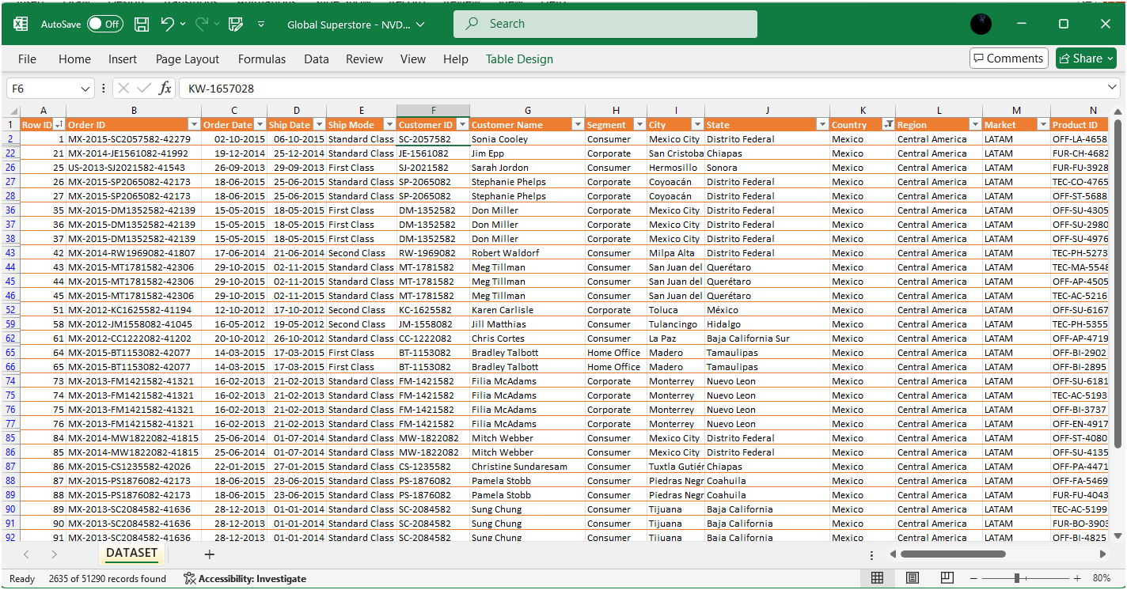
To view only data from the Country “MEXICO”

Slide 15
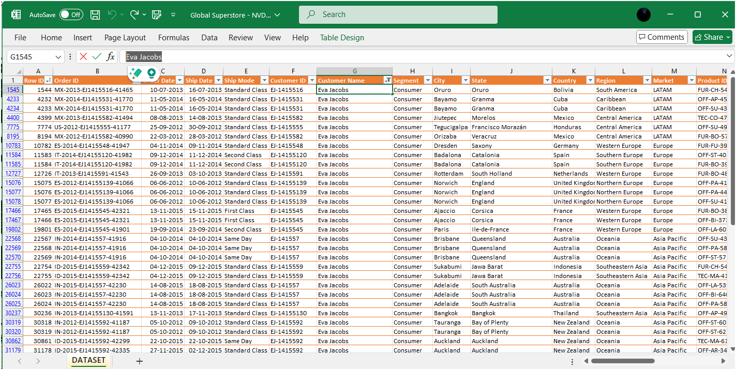
To view only data from the Customer name “Eva Jacobs”

Slide 16
THANK YOU

